Slide 1
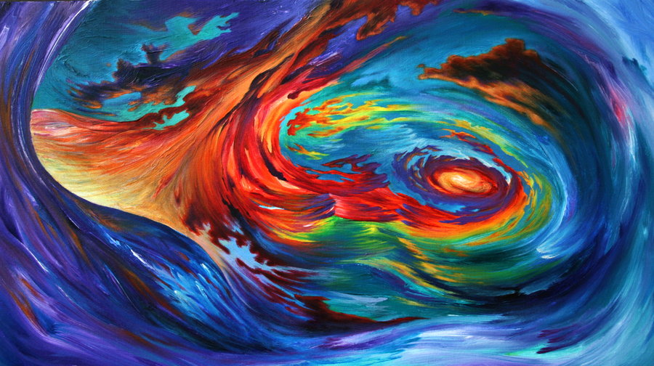
Sunday, June 4th
Pentecost/Pride Sunday
Creation by Justin Christenbery

Slide 2
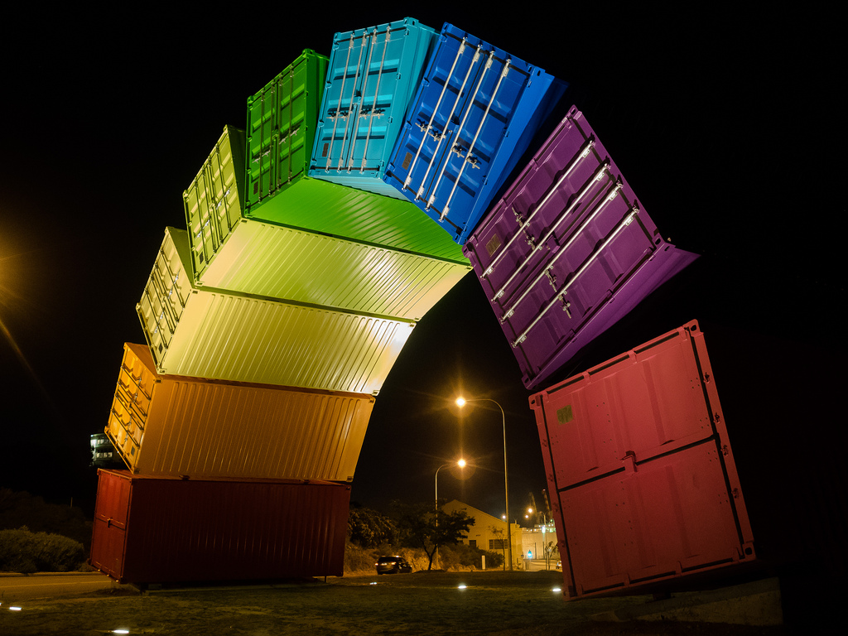
Let Us Build A House
(MV #1)
Rainbow made
from used shipping
containers in Western
Australia

Slide 3
Let us build a house where love can dwell and all can safely live, a place where saints and children tell how hearts learn to forgive.
Built of hope and dreams and visions, rock of faith and vault of grace; here the love of Christ shall end divisions:
All are welcome, all are welcome, all are welcome in this place.

Slide 4
Let us build a house where prophets speak, and word are strong and true, where all God’s children dare to seek to dream God’s reign anew.
Here the cross shall stand as witness, and as symbol of God’s grace; here as one we claim the faith of Jesus:
All are welcome all are welcome, all are welcome in this place.

Slide 5
Let us build a house where love is found in water, whine and wheat; a banquet hall on holy ground, where peace and justice meet.
Here the love of God through Jesus, is revealed in time and space; as we share in Christ the feast that frees us:
All are welcome, all are welcome, all are welcome in this place.

Slide 6
Let us build a house where hands will reach beyond the wood and stone to heal and strengthen, serve and teach, and live the Word they’ve known.
Here the outcast and the stranger bear the image of God’s face;
Let us bring an end to fear and danger:
All are welcome, all are welcome, all are welcome in this place.

Slide 7
Let us build a house where all are named, their songs and visions heard and loved and treasured, taught and claimed as words within the Word.
Built of tears and cries and laughter, prayers of faith and songs of grace; let this house proclaim from floor to rafter:
All are welcome, all are welcome, all are welcome in this place.**

Slide 8
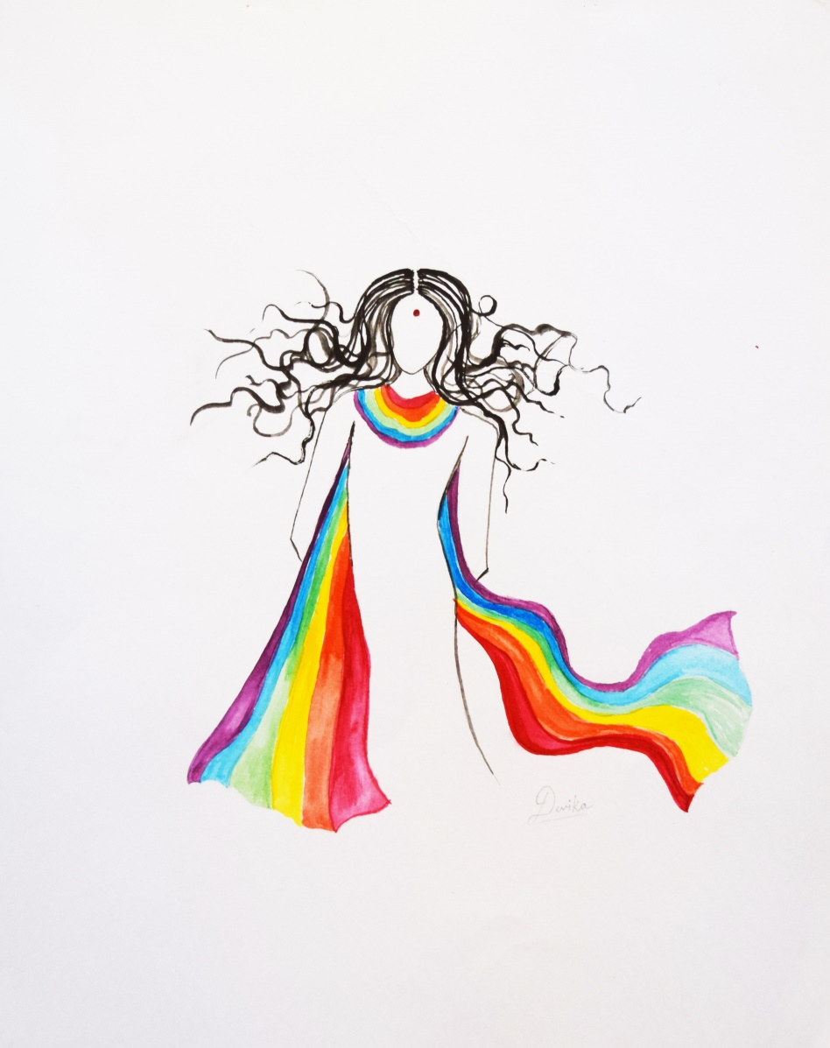
Call to Worship
Pride by Devika Gupta

Slide 9
One: We bid you welcome, who come with wary spirit seeking rest.
All: Who come with troubles that are too much with you, who come hurt and afraid.
One: We bid you welcome, who come with hope in your heart.
All: Who come with anticipation in your step, who come proud and joyous.

Slide 10
One: We bid you welcome, who are seekers of new faith.
All: Who come to probe and explore. Who come to learn.
One: We bid you welcome, who enter into this hall as a homecoming.
All: Who have found here room for your spirit. Who find in this people a family.

Slide 11
One: Whoever you are, whatever you are, wherever you are on your journey.
All: We bid you welcome.

Slide 12
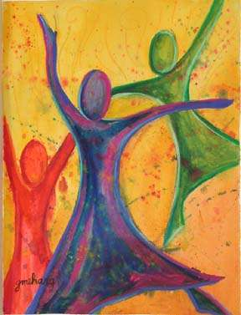
We Are Called
Abandonded Worship
by Gwen Meharg

Slide 13
Come! Live in the light!
Shine with the joy and the love of the Lord!
We are called to be light for the kingdom,
To live in the freedom of the city of God.

Slide 14
We are called to act with justice,
We are called to love tenderly;
We are called to serve one another,
To walk humbly with God.

Slide 15
Come! Sing a new song!
Show your mercy to all those in fear!
We are called to be hope for the hopeless so hatred and blindness will be no more,

Slide 16
We are called to act with justice,
We are called to love tenderly;
We are called to serve one another,
To walk humbly with God.

Slide 17
Sing! Sing a new song!
Sing of that great day when all will be one!
God will reign,
And we’ll walk with each other
As sisters and brothers united in love.

Slide 18
We are called to act with justice,
We are called to love tenderly;
We are called to serve one another,
To walk humbly with God.
To walk humbly with God. **

Slide 19
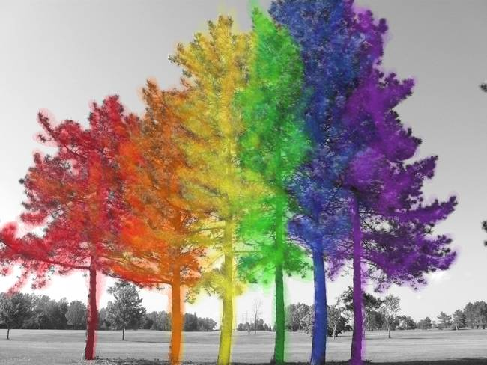
Prayer of Approach
“rainbow tree”
by fuzziebutter

Slide 20
O Holy One, known to us in many ways, be present with us now. We ask for your blessings as we rejoice as a community this day. Bless our pride that it be a humble reflection of gratitude for who it is you have created us to be.

Slide 21
Bless our celebration that it be an expression of our joy in love and in health. Bless our laughter that it herald the building of friendships and relationships. Bless those who may come to oppose us that our happiness may be contagious.

Slide 22
Bless our differences as a source of our strength and a sign of our respect for one another. Bless those for whom it takes great courage to be here that they may feel the abundance of life.

Slide 23
Bless our calls for equity and freedom that we may both speak and hear your vision of justice and of peace. Bless each one of us here today with your presence and our presence, one with another.

Slide 24
O Holy One, we call to you and name you as eternal, ever-present, and boundless in love. Yet there are times, O God, when we fail to recognize you in the dailyness of our lives.

Slide 25
Sometimes shame clenches tightly around our hearts, and we hide our true feelings. Sometimes fear makes us small, and we miss the chance to speak from our strength. Sometimes doubt invades our hopefulness, and we degrade our own wisdom.

Slide 26
Holy God, in the daily round from sunrise to sunset, remind us again of your holy presence hovering near us and in us. Free us from shame and self-doubt. Help us to see you in the moment-by-moment possibilities to live honestly, to act courageously, and to speak from our wisdom.

Slide 27
All this we ask of you, O Holy One, for you are ever faithful to us. Rejoice with us today! Amen.

Slide 28

Acts 2: 1-21
Pride artwork
by Benjamin Faucher

Slide 29
2 ¹⁻⁴ When the Feast of Pentecost came, they were all together in one place. Without warning there was a sound like a strong wind, gale force—no one could tell where it came from. It filled the whole building. Then, like a wildfire, the Holy Spirit spread through their ranks, and they started speaking in a number of different languages as the Spirit prompted them.

Slide 30
⁵⁻¹¹ There were many Jews staying in Jerusalem just then, devout pilgrims from all over the world. When they heard the sound, they came on the run. Then when they heard, one after another, their own mother tongues being spoken, they were thunderstruck.

Slide 31
They couldn’t for the life of them figure out what was going on, and kept saying, “Aren’t these all Galileans? How come we’re hearing them talk in our various mother tongues?
Parthians, Medes, and Elamites;

Slide 32
Visitors from Mesopotamia, Judea, and Cappadocia,
Pontus and Asia, Phrygia and Pamphylia,
Egypt and the parts of Libya belonging to Cyrene;
Immigrants from Rome, both Jews and proselytes;
Even Cretans and Arabs!

Slide 33
“They’re speaking our languages, describing God’s mighty works!”
¹² Their heads were spinning; they couldn’t make head or tail of any of it. They talked back and forth, confused: “What’s going on here?”
¹³ Others joked, “They’re drunk on cheap wine.”

Slide 34
¹⁴⁻²¹ That’s when Peter stood up and, backed by the other eleven, spoke out with bold urgency: “Fellow Jews, all of you who are visiting Jerusalem, listen carefully and get this story straight. These people aren’t drunk as some of you suspect.

Slide 35
They haven’t had time to get drunk—it’s only nine o’clock in the morning. This is what the prophet Joel announced would happen:
“In the Last Days,” God says,
“I will pour out my Spirit on every kind of people:

Slide 36
Your sons will prophesy, also your daughters;
Your young men will see visions, your old men dream dreams.
When the time comes,
I’ll pour out my Spirit

Slide 37
On those who serve me, men and women both, and they’ll prophesy.
I’ll set wonders in the sky above and signs on the earth below,
Blood and fire and billowing smoke, the sun turning black and the moon blood-red,

Slide 38
Before the Day of the Lord arrives, the Day tremendous and marvelous;
And whoever calls out for help to me, God, will be saved.”

Slide 39

1Corinthians
13: 1-13
Love Everlasting
by Omaste Witkowski

Slide 40
If I speak with human eloquence and angelic ecstasy but don’t love, I’m nothing but the creaking of a rusty gate.
² If I speak God’s Word with power, revealing all his mysteries and making everything plain as day, and if I have faith that says to a mountain, “Jump,” and it jumps, but I don’t love, I’m nothing.

Slide 41
³⁻⁷ If I give everything I own to the poor and even go to the stake to be burned as a martyr, but I don’t love, I’ve gotten nowhere. So, no matter what I say, what I believe, and what I do, I’m bankrupt without love.
Love never gives up.
Love cares more for others than for self.

Slide 42
Love doesn’t want what it doesn’t have.
Love doesn’t strut,
Doesn’t have a swelled head,
Doesn’t force itself on others,
Isn’t always “me first,”
Doesn’t fly off the handle,

Slide 43
Doesn’t keep score of the sins of others,
Doesn’t revel when others grovel,
Takes pleasure in the flowering of truth,
Puts up with anything,
Trusts God always,
Always looks for the best,
Never looks back,
But keeps going to the end.

Slide 44
⁸⁻¹⁰ Love never dies. Inspired speech will be over some day; praying in tongues will end; understanding will reach its limit. We know only a portion of the truth, and what we say about God is always incomplete. But when the Complete arrives, our incompletes will be canceled.

Slide 45
¹¹ When I was an infant at my mother’s breast, I gurgled and cooed like any infant. When I grew up, I left those infant ways for good.
¹² We don’t yet see things clearly. We’re squinting in a fog, peering through a mist. But it won’t be long before the weather clears and the sun shines bright!

Slide 46
We’ll see it all then, see it all as clearly as God sees us, knowing him directly just as he knows us!
¹³ But for right now, until that completeness, we have three things to do to lead us toward that consummation: Trust steadily in God, hope unswervingly, love extravagantly. And the best of the three is love.

Slide 47
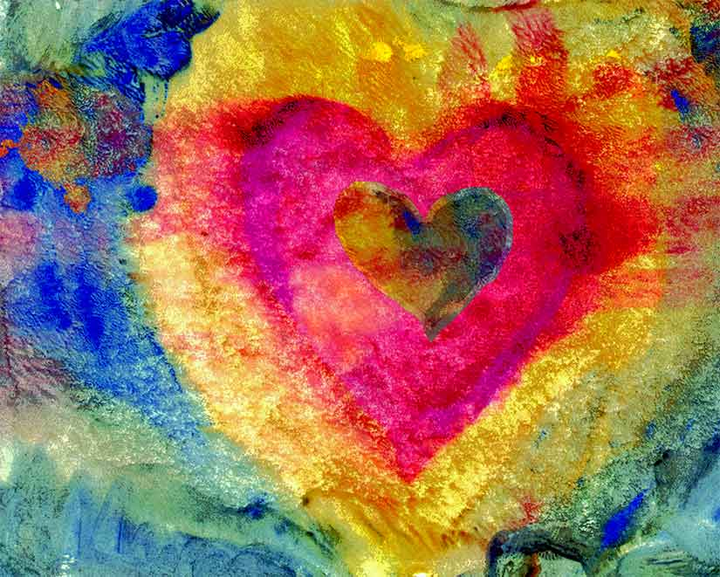
Spirit Open My Heart
(MV # 79)
Heart
by Karen Gillis Taylor

Slide 48
Spirit, open my heart to the joy and pain of living.
As you love may I love, in receiving and in giving,
Spirit, open my heart.

Slide 49
God, replace my stony heart with a heart that’s kind and tender.
All my coldness and fear to your grace I now surrender.

Slide 50
Spirit, open my heart to the joy and pain of living.
As you love may I love, in receiving and in giving,
Spirit, open my heart.

Slide 51
Write your love upon my heart as my law, my goal, my story.
In each thought, word, and deed, my living bring you glory.

Slide 52
Spirit, open my heart to the joy and pain of living.
As you love may I love, in receiving and in giving,
Spirit, open my heart.

Slide 53
May I weep with those who weep, share the joy of sister, brother.
In the welcome of Christ, may we welcome one another.

Slide 54
Spirit, open my heart to the joy and pain of living.
As you love may I love, in receiving and in giving,
Spirit, open my heart.**

Slide 55
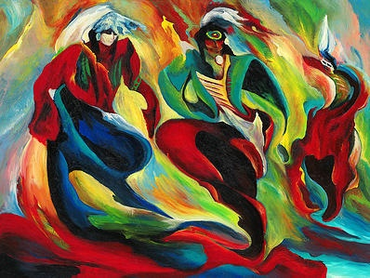
Offering
Pride, Honor and Respect
by JoAnne Bird

Slide 56
With a vision of hope we move along.
Empowered by faith we carry on.
Reaching out far and wide,
Moving forward, reaching high.
Filled with hope, filled with dreams,
We journey on.**

Slide 57
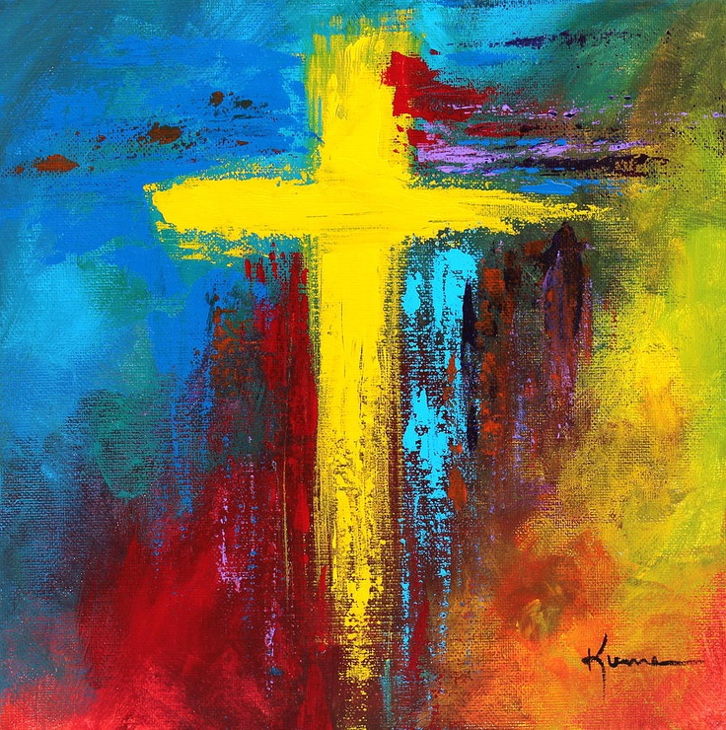
Communion
Cross by Kume Bryan

Slide 58
One: God is with us.
All: Here in this place;
One: at this time of sacred refreshment and renewal.
All: Called in grace and gifted in love.

Slide 59
God, you know us better than we know ourselves.
You know our thoughts, our weaknesses, our motivations, our sins.
And you love us still.

Slide 60
Forgive us when we don't believe such love is true or possible; when we wonder how you could love us just as we are, when we forget our intricate construction, fearfully, wonderfully made, in your image!

Slide 61
Remove from our minds every thought which keeps us from you.
Break down the walls, push aside our self-centered ways and help us to trust anew.
You know our hearts.

Slide 62
And you love us still and knowing this we lift up those in this community today who long to feel your presence in their lives…….

Slide 63
We also pray for all those members of the LGBTTQ community who continue to face oppression and violence as a daily reality of their lives, may your presence gently hold them.

Slide 64
We pray for those who have been separated from family and friends because of who they are and who they love, may you love fill their hearts and souls. We pray for our world that we may truly come to understand what your love can really mean to all of us.

Slide 65
God of our ancestors and God of our children, we come knowing we have preferred to test you, rather than to trust you. The famine in our souls makes us long to be filled with the empty promises of the world.

Slide 66
We listen to the soothing words of the advertisers, rather than to the uncomfortable call of your love.
Forgive us, God of our lives. Bring us out of that dependence on ourselves, and bring us into the presence of the One we seek to follow, not only to Jerusalem, but beyond — into life with you forever Amen.

Slide 67
Called in grace and gifted in love, Jesus gathered with his friends and shared a meal; the setting simple, the meaning profound.
Bread of life, cup of blessing.
"This is my body. This is my blood.
Do this in remembrance of me."

Slide 68
This table is God's offer of grace and an invitation to community where forgiveness is found and we are called to be the body of Christ.
In that body, we find all shapes, sizes, and abilities, the young and the old, all colors and shades, and the created diversity of loving relationships.

Slide 69
Together, we are affirmed in our shared mission, and empowered for discipleship.
No one goes hungry. This table welcomes everyone!
Come, share the feast!

Slide 70
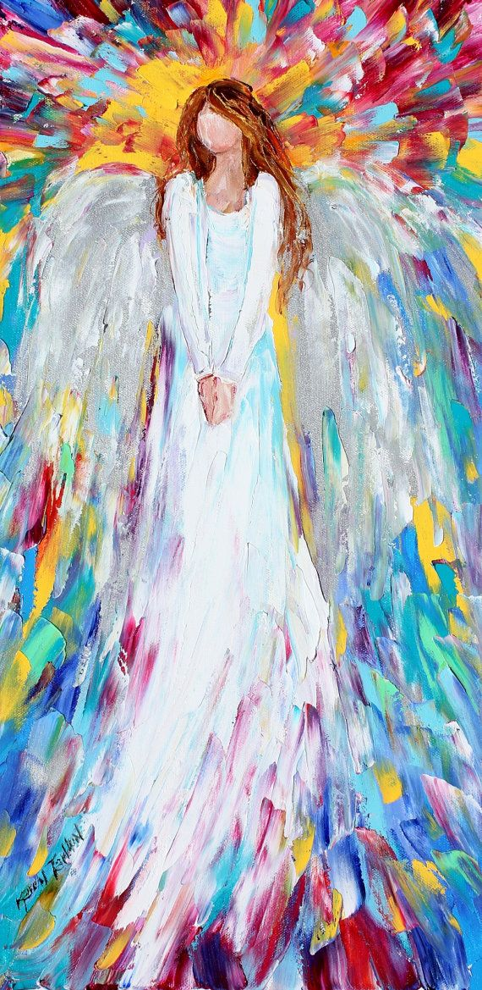
Prayer of Thanksgiving
Angel Watching Over Me
by Karen Tarlton

Slide 71
We give thanks to you, God, for this meal. Simple. Elegant. Refreshing. Re-creating. May we hear the call: love one another as you have loved us. One body, many members, the body of Christ. Amen.

Slide 72
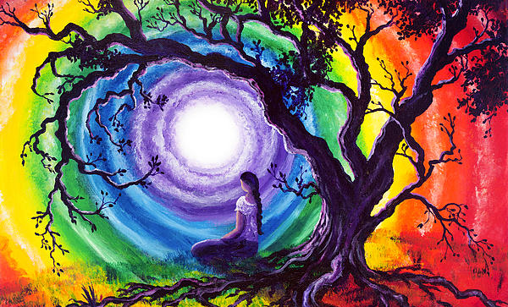
Reflection
Tree of Life Meditation
by Laura Iverson

Slide 73
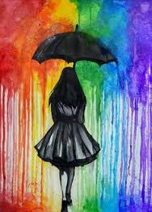
Wind of Change

Slide 74
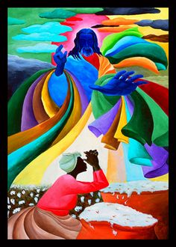
Litany of Freedom
Field of Prayers
by Ivey Hayes

Slide 75
All: We, as people of faith with many different sexual orientations and gender identities and expression, claim the promise of the rainbow, the promise of Creation’s sustaining love.

Slide 76
From the Hebrew Scriptures, we read: This is the sign of the covenant that I make between me and you and every living creature that is with you, for all generations: I have set my bow in the clouds, and it shall be a sign of the covenant between me and the earth. When the bow is seen in the clouds, I will remember my covenant that is between me and you and every living thing.

Slide 77
All: We proclaim our pride.

Slide 78
It is much easier for society and many homophobic religions to tolerate a gay gay person who sits quietly and doesn’t speak up, than a proud and creative gay man, lesbian, transgender or two-spirit person. May we march with pride and creativity in our whole lives.

Slide 79
All: We proclaim our bold intentions

Slide 80
With Rev. Dr. Martin Luther King, Jr., we remember that the oppressed set both the time table and the agenda for liberation. If we say now is the time, then now is the time. May wisdom sustain us.

Slide 81
All: We remember that we are not isolated or alone in either our oppression or our struggle.

Slide 82
May our pride and our quest for freedom light a flame within us that is a passion for justice for all who are disregarded, overlooked, or oppressed: First Nations peoples, African-Canadians, women, the poor in Canada and throughout the world, those with disabilities, our elders.

Slide 83
May we realize our own participation in fear and denial, in injustice and lovelessness, and do what we can each day to live in equity and love.

Slide 84
All: We proclaim ourselves as people of faith, living for right relation in our world.

Slide 85
May we become the bread of life, the wine of forgiveness and reconciliation as we break and pour ourselves out in the struggle against oppression and hopelessness.

Slide 86
All: We proclaim our vision of diversity and hope and our responsibility to share this vision.

Slide 87
May we join with one another and the spirit to follow in the way of the Hebrew prophet Isaiah by bringing good news to the oppressed, binding up the broken-hearted, comforting all who mourn, offering the oil of gladness and lasting joy.

Slide 88
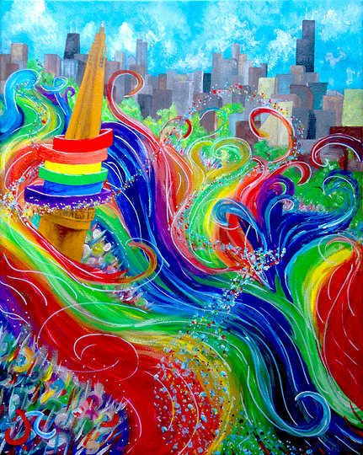
With One Voice
Chicago Pride Parade
by James Rudolph

Slide 89
Take the Word and go out to every land:
Shine the light of Christ for all to see!
May the lives of those we touch sing praise to God above.
Let us sing,
We’ll sing:

Slide 90
With one voice we’ll pass the Word along;
With one voice, bring justice to the world.
And with all the angels we’ll spread the goodness of God.
With all power and glory the Word of God shall reign.

Slide 91
Take the Word to our neighbourhoods and streets
Shine the light of Christ for all to see!
May we all set out to live in peace and harmony.
They will see and sing:

Slide 92
With one voice we’ll pass the Word along;
With one voice, bring justice to the world.
And with all the angels we’ll spread the goodness of God.
With all power and glory the Word of God shall reign.

Slide 93
Take the Word to the people in despair;
Shine the light of Christ for all to see!
May our actions and our deeds brings comfort to their needs.
And they’ll know and sing:

Slide 94
With one voice we’ll pass the Word along;
With one voice, bring justice to the world.
And with all the angels we’ll spread the goodness of God.
With all power and glory the Word of God shall reign.**

Slide 95
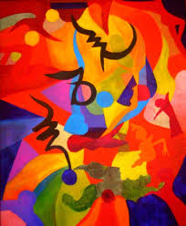
Benediction
Singing Praise
by Peter Shor

Slide 96
Response
May the grace of Christ attend us,
And the love of God surround us,
And the Holy Spirit keep us now and ever, always.
Amen, amen, forever and ever. Amen.**

